Slide 1


CS214 – Data Structures
Lecture 16: Trees IV
Slides by
Mohamed El-Ramly, PhD
Basheer Youssef, PhD
Notes:
Polls in slides:
in lecture 1: 24,29,31,32,42,46
in lecture 2: 65,84,102,103,108,117,130

Slide 2
Agenda
  Introduction to Binary Trees
  Implementing Binary Trees
  Searching Binary Search Trees
  Tree Traversal …1. Breadth-First ….2. Depth-First
  Insertion
  Deletion by Copying
  Balanced Trees
  Heaps / Heap Sort

Slide 3
6.7 Tree Balancing
The disadvantage of a binary search tree is that its height can be as large as n-1.
This means that the time needed to perform insertion and deletion and many other operations can be O(n) in the worst case
We want a tree with small height

Slide 4
6.7 Tree Balancing
A binary tree with n node has height at least Θ(log n)
Thus, our goal is to keep the height of a binary search tree O(log n)
Such trees are called balanced binary search trees. Examples are AVL tree, red-black tree.

Slide 5
6.7 Tree Balancing
A balanced tree is one who has the difference in height of both subtrees of any node in the tree is either one or zero.
A perfectly balanced tree is one who is balanced and has all the leaves at the same level.

Slide 6
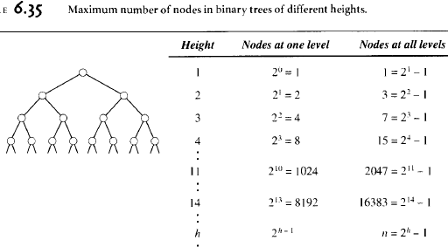

Slide 7
6.7 Tree Balancing
Technique 1: Continuously restructure the tree when new elements arrive that cause imbalance in the tree. So, we always keep the tree balanced. (AVL, DSW)
Technique 2: Reorder the data and then build the tree so that it is balanced.

Slide 8
AVL Trees
Locally change the tree to rebalance it after an insertion or deletion.
Named after Adel’son-Vel’skii and Landis.
The height of every left and right subtrees of a node differ by one at most.
No guarantee that the resulting tree is perfectly balanced.
https://www.cs.usfca.edu/~galles/visualization/AVLtree.html

Slide 9
AVL Trees
Height of a node
The height of a leaf is 1. The height of a null pointer is zero.
The height of an internal node is the maximum height of its children plus 1

Slide 10
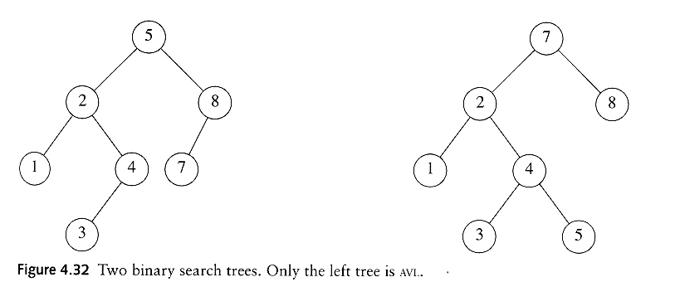
AVL tree
An AVL tree is a binary search tree in which
  for every node in the tree, the height of the left and right subtrees differ by at most 1.
AVL property violated here

Slide 11
AVL Tree Complexity
in big O notation
 | Average | Worst case
Space | O(n) | O(n)
Search | O(log n) | O(log n)
Insert | O(log n) | O(log n)
Delete | O(log n) | O(log n)
Time complexity in big O notation
 | Average | Worst case
Space | O(n) | O(n)
Search | O(log n) | O(log n)
Insert | O(log n) | O(log n)
Delete | O(log n) | O(log n)

Slide 12
AVL Tree Balancing
Balance factor is the difference between the right subtree and the left subtree.
If |balance factor| becomes > 1, then the tree has to be rebalanced.
For insertion, this can happen in four cases, but two are symmetric to the other two:
  Insertion in the right tree of the right child
  Insertion in the left tree of the right child

Slide 13
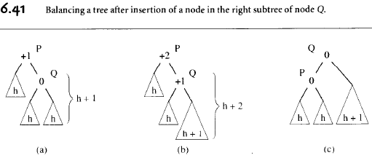
Insertion in the R tree of the R child
Single rotation is needed.

Slide 14
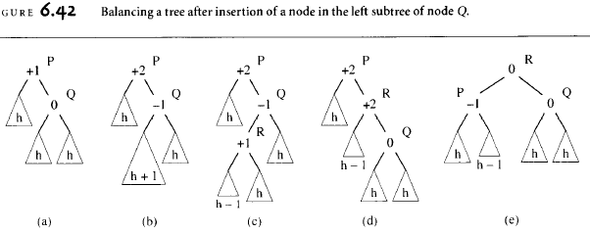
Insertion in the L tree of the R child
Double rotation is needed.

Slide 15
Rotations
When the tree structure changes (e.g., insertion or deletion), we need to transform the tree to restore the AVL tree property.
This is done using single rotations or double rotations.
e.g. Single Rotation
y
x
x
y
C
A
C
B
B
A
Before Rotation
After Rotation

Slide 16
Rotations
Since an insertion/deletion involves adding/deleting a single node, this can only increase/decrease the height of some subtree by 1
Thus, if the AVL tree property is violated at a node x, it means that the heights of left(x) ad right(x) differ by exactly 2.
Rotations will be applied to x to restore the AVL tree property.

Slide 17
Insertion
First, insert the new key as a new leaf just as in ordinary binary search tree
Then trace the path from the new leaf towards the root. For each node x encountered, check if heights of left(x) and right(x) differ by at most 1.
If yes, proceed to parent(x). If not, restructure by doing either a single rotation or a double rotation [next slide].
For insertion, once we perform a rotation at a node x, we won’t need to perform any rotation at any ancestor of x.

Slide 18
Insertion
Let x be the node at which left(x) and right(x) differ by more than 1
Assume that the height of x is h+3
There are 4 cases
  Height of left(x) is h+2 (i.e. height of right(x) is h)
    Height of left(left(x)) is h+1 ⇒ single rotate with left child
    Height of right(left(x)) is h+1 ⇒ double rotate with left child
  Height of right(x) is h+2 (i.e. height of left(x) is h)
    Height of right(right(x)) is h+1 ⇒ single rotate with right child
    Height of left(right(x)) is h+1 ⇒ double rotate with right child

Slide 19
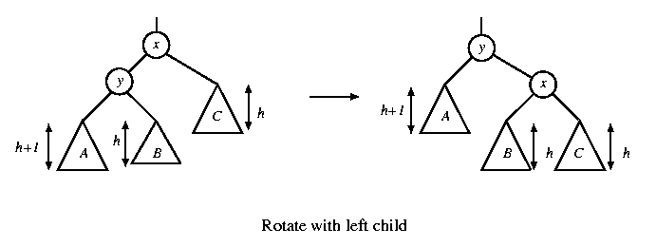
Single rotation
The new key is inserted in the subtree A.
The AVL-property is violated at x
height of left(x) is h+2
height of right(x) is h.

Slide 20
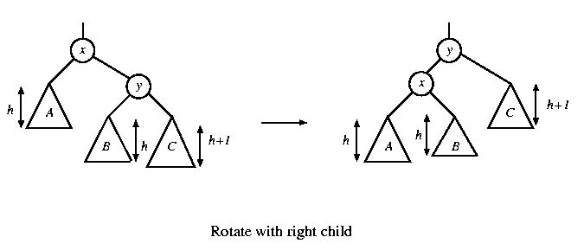
Single rotation
The new key is inserted in the subtree C.
The AVL-property is violated at x.
Single rotation takes O(1) time.
Insertion takes O(log N) time.

Slide 21
x
AVL Tree
5
5
y
8
C
3
3
8
1
4
B
1
4
A
0.8
Insert 0.8
3
5
1
After rotation
4
8
0.8

Slide 22
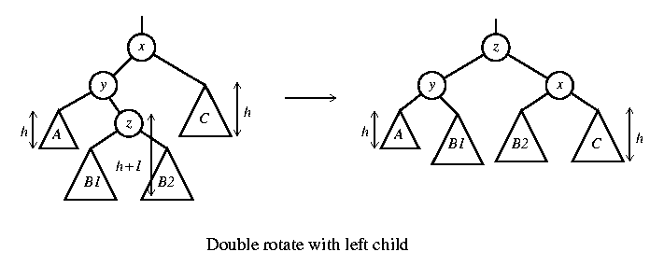
Double rotation
The new key is inserted in the subtree B1 or B2.
The AVL-property is violated at x.
x-y-z forms a zig-zag shape
also called left-right rotate

Slide 23
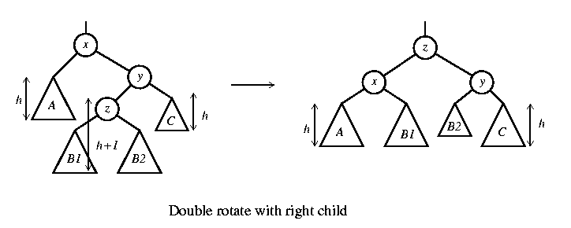
Double rotation
The new key is inserted in the subtree B1 or B2.
The AVL-property is violated at x.
also called right-left rotate

Slide 24
Double Rotation – in more detail
A Double Rotation is like 2 single rotations.
  Example: Left-right double rotation.
k₃
Single Left Rotation at K₁
k₃
k₁
D
k₂
D
A
k₂
k₁
C
B
C
A
B
Single Right Rotation at K₃
k₂
k₁
k₃
A
B
C
D

Slide 25
x
5
AVL Tree
5
C
y
8
3
3
8
A
1
4
z
1
4
B
3.5
Insert 3.5
4
5
3
3.5
8
After Rotation
1

Slide 26
An Extended Example
Insert 3,2,1,4,5,6,7, 16,15,14
Single rotation
3
2
3
3
2
1
Fig 1
2
3
Fig 4
Fig 2
2
1
2
Single rotation
Fig 3
1
1
3
3
Fig 5
Fig 6
4
4
5

Slide 27
2
2
Single rotation
1
4
1
4
3
5
3
5
Fig 8
Fig 7
6
4
4
Single rotation
2
5
2
5
1
3
6
1
3
6
4
Fig 9
Fig 10
7
2
6
1
3
7
5
Fig 11

Slide 28
4
2
6
1
3
7
5
16
Fig 12
4
Double rotation
4
2
6
2
6
1
3
7
1
3
15
5
16
5
16
Fig 13
7
15
Fig 14

Slide 29
4
4
Double rotation
2
6
2
7
15
1
3
15
1
3
5
6
16
7
5
14
16
Fig 15
14
Fig 16

Slide 30
Deletion
Delete a node x as in ordinary binary search tree. Note that the last node deleted is a leaf.
Then trace the path from the new leaf towards the root.
For each node x encountered, check if heights of left(x) and right(x) differ by at most 1. If yes, proceed to parent(x). If not, perform an appropriate rotation at x. There are 4 cases as in the case of insertion.
For deletion, after we perform a rotation at x, we may have to perform a rotation at some ancestor of x. Thus, we must continue to trace the path until we reach the root.

Slide 31
Deletion
On closer examination: the single rotations for deletion can be divided into 4 cases (instead of 2 cases)
  Two cases for rotate with left child
  Two cases for rotate with right child

Slide 32
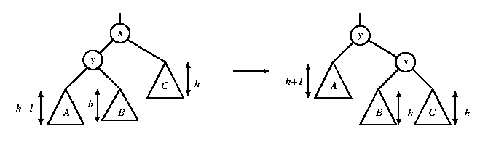
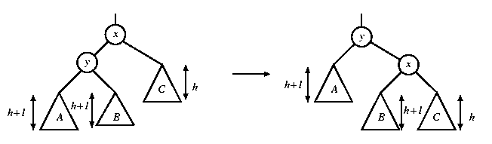
Single rotations in deletion
In both figures, a node is deleted in subtree C, causing the height to drop to h. The height of y is h+2. When the height of subtree A is h+1, the height of B can be h or h+1. Fortunately, the same single rotation can correct both cases.
rotate with left child

Slide 33
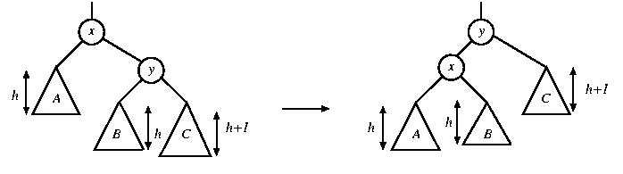
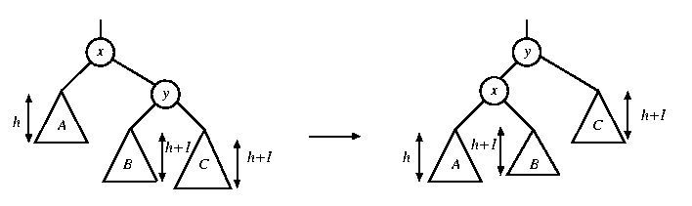
Single rotations in deletion
In both figures, a node is deleted in subtree A, causing the height to drop to h. The height of y is h+2. When the height of subtree C is h+1, the height of B can be h or h+1. A single rotation can correct both cases.
rotate with right child

Slide 34
Rotations in deletion
There are 4 cases for single rotations, but we do not need to distinguish among them.
There are exactly two cases for double rotations (as in the case of insertion)
Therefore, we can reuse exactly the same procedure for insertion to determine which rotation to perform

Slide 35


Slide 36
AVL Examples
Tree Tool – You must try it
https://www.cs.usfca.edu/~galles/visualization/AVLtree.html
http://www.qmatica.com/DataStructures/Trees/AVL/AVLTree.html http://groups.engin.umd.umich.edu/CIS/course.des/cis350/treetool/index.html
http://eternallyconfuzzled.com/tuts/datastructures/jsw_tut_avl.aspx
http://www.cmcrossroads.com/bradapp/ftp/src/libs/C++/AvlTrees.html

Slide 37
AVL Tree Example:
Insert 14, 17, 11, 7, 53, 4, 13 into an empty AVL tree
14
11
17
7
53
4

Slide 38
AVL Tree Example:
Insert 14, 17, 11, 7, 53, 4, 13 into an empty AVL tree
14
7
17
4
11
53
13

Slide 39
AVL Tree Example:
Now insert 12
14
7
17
4
11
53
13
12

Slide 40
AVL Tree Example:
Now insert 12
14
7
17
4
11
53
12
13

Slide 41
AVL Tree Example:
Now the AVL tree is balanced.
14
7
17
4
12
53
11
13

Slide 42
AVL Tree Example:
Now insert 8
14
7
17
4
12
53
11
13
8

Slide 43
AVL Tree Example:
Now insert 8
14
7
17
4
11
53
8
12
13

Slide 44
AVL Tree Example:
Now the AVL tree is balanced.
14
11
17
7
12
53
4
8
13

Slide 45
AVL Tree Example:
Now remove 53
14
11
17
7
12
53
4
8
13

Slide 46
AVL Tree Example:
Now remove 53, unbalanced
14
11
17
7
12
4
8
13

Slide 47
AVL Tree Example:
Balanced! Remove 11
11
7
14
4
8
12
17
13

Slide 48
AVL Tree Example:
Remove 11, replace it with the largest in its left branch
8
7
14
4
12
17
13

Slide 49
AVL Tree Example:
Remove 8, unbalanced
7
4
14
12
17
13

Slide 50
AVL Tree Example:
Remove 8, unbalanced
7
4
12
14
13
17

Slide 51
AVL Tree Example:
Balanced!!
12
7
14
4
13
17

Slide 52
In Class Exercises
Build an AVL tree with the following values:
  15, 20, 24, 10, 13, 7, 30, 36, 25

Slide 53
  15, 20, 24, 10, 13, 7, 30, 36, 25
20
15
15
24
20
10
24
13
20
20
13
24
15
24
10
15
13
10

Slide 54
  15, 20, 24, 10, 13, 7, 30, 36, 25
20
13
13
24
10
20
10
15
7
15
24
7
30
13
36
10
20
7
15
30
24
36

Slide 55
  15, 20, 24, 10, 13, 7, 30, 36, 25
13
13
10
20
10
20
7
15
30
7
15
24
24
36
30
25
13
25
36
10
24
7
20
30
15
25
36

Slide 56
  Remove 24 and 20 from the AVL tree.
13
13
10
24
10
20
7
20
30
7
15
30
15
25
36
25
36
13
13
10
30
10
15
7
15
36
7
30
25
25
36

